Slide 1

PROJECT ON
ENERGY CONSUMPTION ANALYSIS
USING MySQL
Presented By : Venkata Naga Sai Prabhath Devalla
Batch No: 435
Branch: Dilsukhnagar

Slide 2


About me:
My name is Venkata Naga Sai Prabhath Devalla.
I have completed my Bachelor of Technology (B.Tech) in Electrical and Electronics Engineering (EEE), from SRK Institute of Technology.
I chose Data Science to transform data into meaningful insights that support better decision-making.
You can find my professional presence here:
LinkedIn : linkedin.com/in/venkata-naga-sai-prabhath-devalla-956b64259
GitHub : https://github.com/SaiPrabhathDevalla

Slide 3

Agenda :
Business Problem
Objective
Entity Relationship (ER) Diagram
Schema Explanation
Tables
Key Analysis Questions
Key Insights
Recommendations
Conclusion

Slide 4

Business problem :
Rising energy demand and emissions make it difficult to balance economic growth with environmental sustainability.
There is a lack of integrated data analysis linking energy consumption, production, emissions, GDP, and population.
Decision-makers struggle to identify inefficiencies and compare country-level performance using reliable insights.
Data-driven insights are needed to support sustainable energy planning and low-carbon policy decisions.
Limited visibility into long-term trends makes it hard to understand how energy usage and emissions evolve over time.
Insufficient benchmarking against global best practices restricts the ability to adopt effective and cleaner energy strategies.

Slide 5

Objective:
The main objective of this project is to analyze global energy and environmental trends using a well-structured MySQL database. The project organizes data related to countries, energy consumption, production, emissions, GDP, and population in a relational format for effective analysis.
Using SQL queries, the project examines energy production and consumption patterns across countries and studies how emissions, population growth, and economic factors influence energy usage.
The goal is to transform raw global data into meaningful insights that enable country comparisons, evaluate environmental performance, and support data-driven decisions for sustainable energy management.

Slide 6

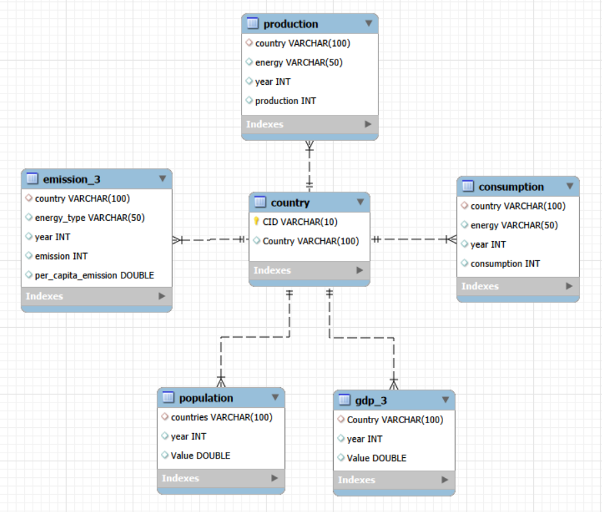
Entity Relationship (ER) Diagram :

Slide 7
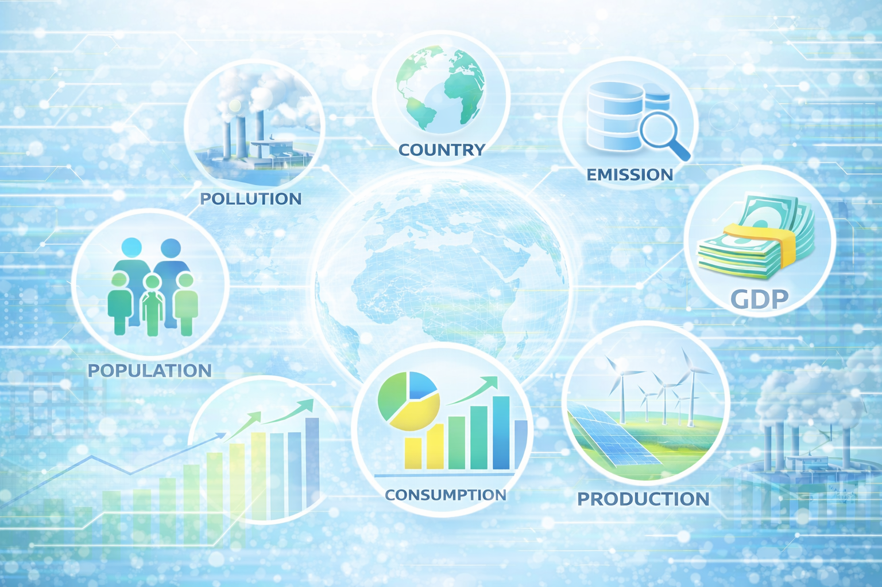
Schema Explanation :
The schema is designed to analyze global energy consumption, production, emissions, GDP, and population using a structured MySQL relational database. It enables efficient storage, retrieval, and comparison of energy and environmental data across countries and years.
Country (Master Table) :
The Country table acts as the master table in the schema. It stores unique country identifiers and country names. All other tables are connected to this table using foreign keys, ensuring data integrity and eliminating data redundancy.
Production :
The Production table stores information about energy produced by each country, categorized by energy type and year. This table helps analyze energy generation patterns and compare production levels across countries.

Slide 8
Schema Explanation :
Consumption :
The Consumption table contains data on energy usage by countries for each year. It allows comparison between energy consumption and production to identify energy-demand and supply trends.
Emission :
The Emission table records total emissions and per-capita emissions generated from different energy sources. This table is essential for assessing the environmental impact of energy consumption.
Population:
The Population table stores year-wise population data for each country. It supports per-capita analysis and helps study how population growth affects energy consumption and emissions.

Slide 9
Schema Explanation :
GDP :
The GDP table contains economic data for each country by year. It helps evaluate the relationship between economic growth and energy usage and supports calculations such as emission-to-GDP ratios.
Overall, this schema supports trend analysis, cross-country comparisons, per-capita calculations, and sustainability evaluation by linking energy, environmental, economic, and population data in a well-organized relational structure.

Slide 10
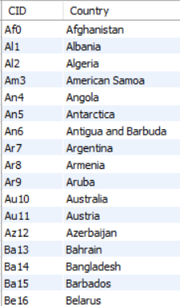
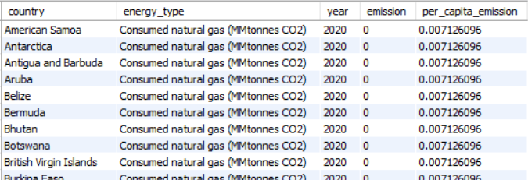
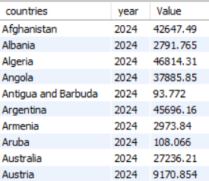
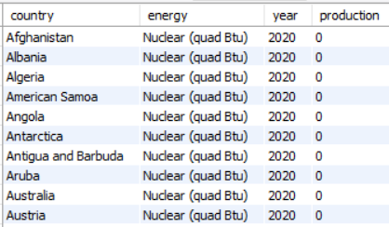
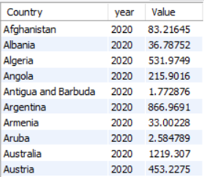
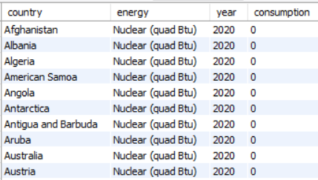
Tables :
Country Emission_3 Population
Production GDP_3 Consumption

Slide 11
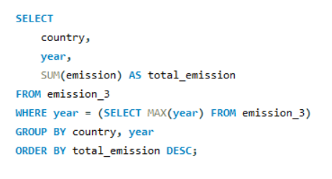
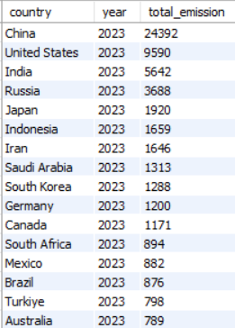
What is the total emission per country for the most recent year available?
Key Analysis Questions :
Query
Output

Slide 12
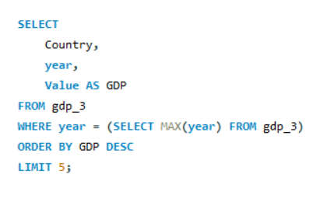
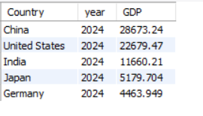
What are the top 5 countries by GDP in the most recent year?
Query
Output

Slide 13
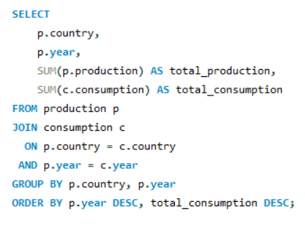
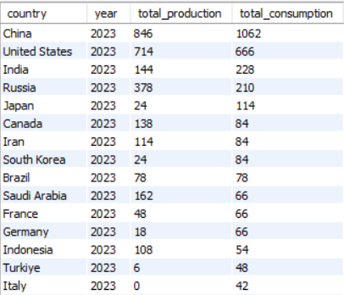
Compare energy production and consumption by country and year.
Query
Output

Slide 14
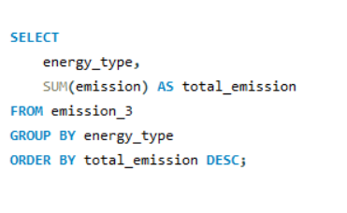
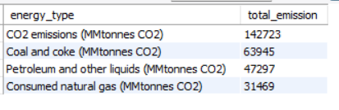
Which energy types contribute most to emissions across all countries?
Query
Output

Slide 15
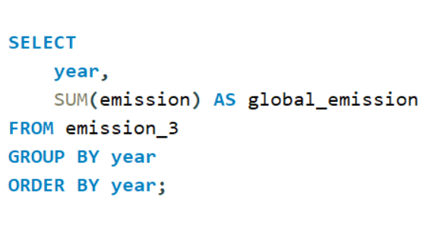
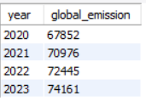
How have global emissions changed year over year?
Query
Output

Slide 16
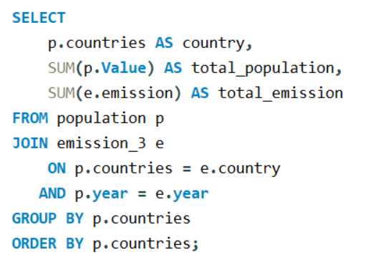
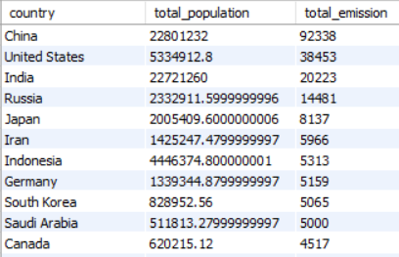
How has population growth affected total emissions in each country?
Query
Output

Slide 17
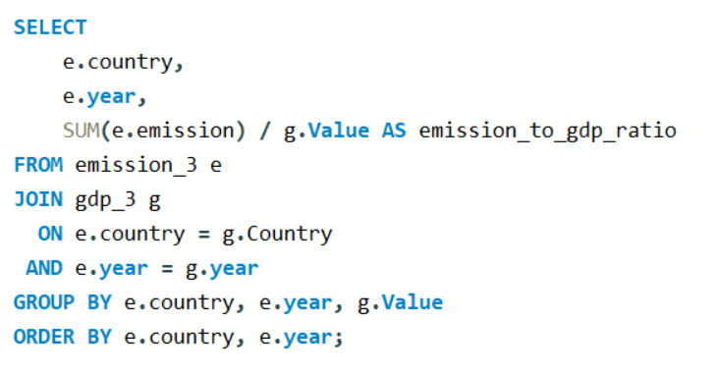
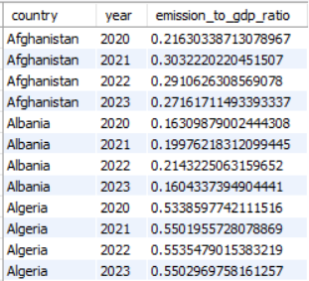
What is the emission-to-GDP ratio for each country by year?
Query
Output

Slide 18
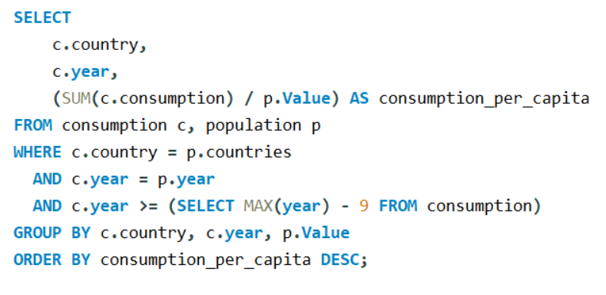
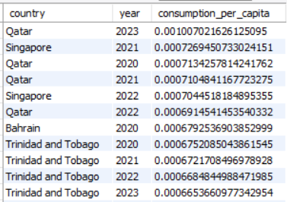
What is the energy consumption per capita for each country over the last decade?
Query
Output

Slide 19
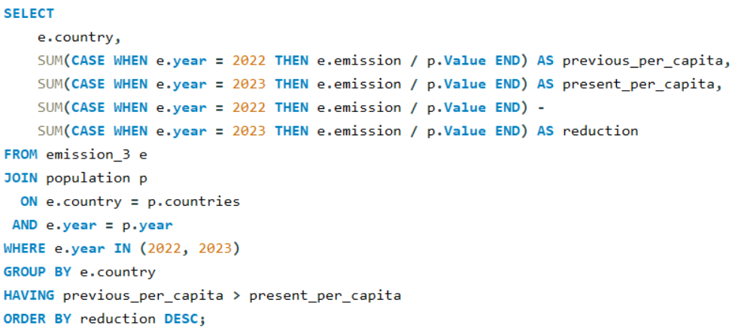
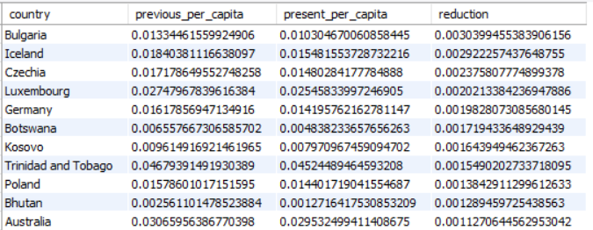
Which countries have improved (reduced) their per capita emissions the most over the last decade?
Query
Output

Slide 20
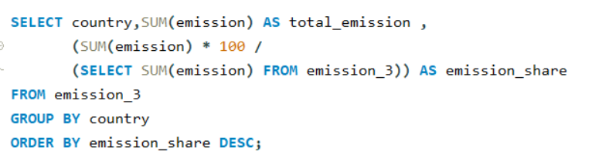
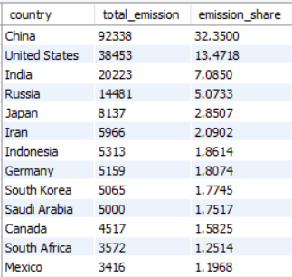
What is the global share (%) of emissions by country?
Query
Output

Slide 21

Key Insights :
Global energy consumption is rising, mainly due to population growth and economic development.
A small number of countries (China, USA, India) account for a major share of energy use and emissions.
Fossil fuels dominate energy supply, making them the primary source of global emissions.
Global energy consumption continues to rise, driven by population growth and expanding economic activity.
A small group of countries - China, the USA, and India - contribute a significant share of global energy use and emissions, highlighting their critical role in sustainability efforts.
Fossil fuels remain the dominant energy sources, making them the primary contributors to global emissions and environmental impact.

Slide 22
Adopt sustainable energy policies that balance economic growth with environmental protection.
Recommendations :
Increase renewable energy usage to reduce emissions and minimize dependence on fossil fuels.
Improve energy efficiency through cleaner technologies, modern infrastructure, and better energy management practices.
Promote data-driven decision-making by continuously analyzing energy consumption, emissions, GDP, and population trends.
Encourage investment in low-carbon technologies to support long-term sustainable development.
Strengthen international benchmarking and collaboration to adopt best practices from energy-efficient countries.

Slide 23

Conclusion :
Energy consumption and emissions are concentrated in a few large economies, mainly due to high population, industrial activity, and economic growth.
Fossil fuels remain the major source of emissions, especially coal, oil, and gas, showing a strong link between energy use and environmental impact.
Some countries show better energy efficiency, producing more economic output with relatively lower emissions.
Population growth and rising energy demand directly increase emissions, highlighting the need for sustainable energy planning.
Renewable energy adoption and efficiency improvements are critical to reducing emissions while supporting economic development.

Slide 24
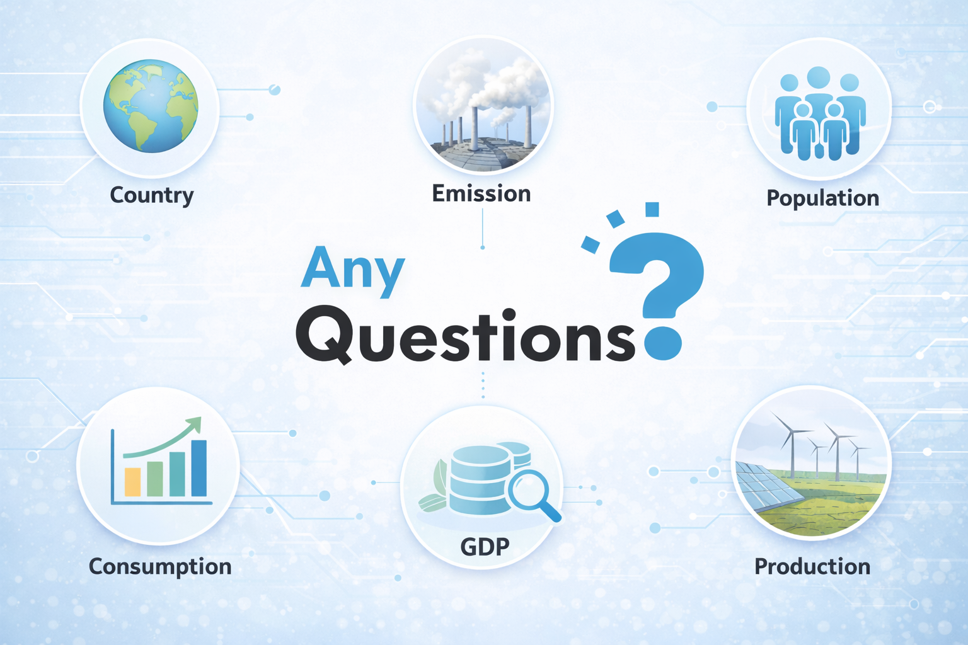

Slide 25


